Slide 1
IDEX Heath and Science (IH&S)
Sustainability
2025

Slide 2
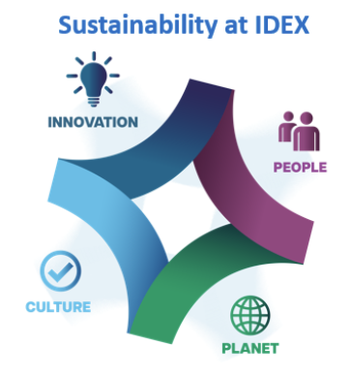
Green House Gas Emission Goal - IDEX
In 2021, IDEX Corporation set an ambitious goal of reducing Scope 1 and Scope 2 emission intensity (by revenue) by 30% by 2035.
  IDEX Corporation’s 2024 Sustainability Report we align with SASB and report using GRI: Link

Slide 3
Green House Gas Emission Goal – IH&S
  IDEX Health and Science has an accelerated goal; we are committed to reducing our absolute Scope 1 and Scope 2 emissions by a minimum of 30% by 2029 with a baseline year of 2022. Link
  *M = Metric Tons
Year | Scope 1 Emissions (MtCO2e) | Scope 2 Emissions (MtCO2e) | Total Emissions (MtCO2e) | Reduction from Baseline
2022 | 773 | 2772 | 3545 | -
2023 | 561 | 2529 | 3090 | 13%
2024 | 535 | 2352 | 2887 | 7%

Slide 4
IH&S Sustainability Story
Our Sustainability Story
At IDEX, we believe that sustainability drives growth and provides value to our stakeholders. Sustainability is rooted in the IDEX culture, values, and mission with a strategic focus on product innovation and creating a positive impact for people and the planet.
  Each year, we complete the EcoVadis assessment. Our current score increased by 7 points from last year, reaching 50%, and we earned a 'Committed Badge' in recognition of our progress
  IDEX Health and Science ERC in Kawaguchi, Japan is ISO 14001
  All sites are working on an internal IDEX Green certification
  IDEX Health and Science’s, IDEX Corporation’s Sustainability Page: Link
  IDEX Corporation’s 2024 Sustainability Report we align with SASB and report using GRI: Link

Slide 5
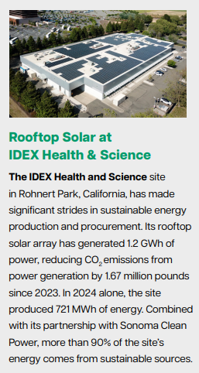

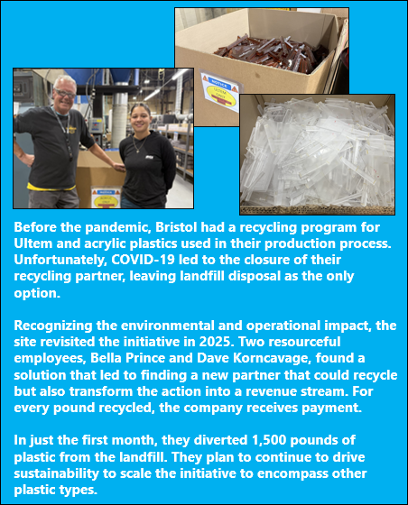
IH&S Sustainability Story
  IDEX Health and Science has partnered with our utility providers to purchase 100% renewable energy, sourced from hydro, wind, and other fully renewable sources.
  We’ve implemented solar panel installations at Business Units where it’s feasible, and we continue to evaluate energy usage across all sites to identify opportunities for further expansion.
  We regularly assess high-emission equipment, such as air compressors, to ensure any leaks are promptly repaired. We've transitioned most sites to 100% LED lighting, established procedures to power down equipment during non-operational hours, and actively recycle materials from our manufacturing processes to minimize landfill waste.
  We also conduct 'Treasure Hunts' in collaboration with third-party experts to uncover opportunities for reducing greenhouse gas emissions from high energy sources

Slide 6

IDEX and IH&S Code of Business Conduct and Ethics
IDEX and IDEX Health and Science have adopted the Code of Business Conduct and Ethics, which outlines the company’s commitment to conducting itself with honesty, fairness and integrity and to observing the rule and spirit of the legal and regulatory environment in which the company operates. The code is rooted in IDEX’s values and defines the fundamental ethical standards that we expect of everyone who works for IDEX, including our contractors, suppliers, and partners.

Slide 7
Questions
If your company has additional questions about IDEX Health & Science or IDEX Corporation’s Sustainability, please contact:
IHSCompilance@idexcorp.com

